Slide 1
INFO411 Data Mining and Knowledge Discovery
Project 09: Energy Rating Data for Air Conditioners

Slide 2
Group Members:
Harris Fun Sai Weng (6353162)
Ephraim Guo Yanyu (6213224)
Leslie Callum Lim (6276167)
Hannah Chua Hui Zhen (6276325)
Noor Mazlina Binte Hajashiek Allaudin (6271959)
All members contributed equally.

Slide 3
Introduction: Energy Label Prediction
To examine and predict the yearly energy consumption and the SRI ratings for the air conditioners that were sold in Australia from 2010.
Notes:
For this particular project that we have chosen, we were tasked to predict the yearly energy consumption of air conditioner in both of the heating and cooling element. We were also tasked to predict the SRI values in both the heating and cooling ratings as well.

Slide 4
Methods: Problems & Solutions
Missing data which impacts the accuracy of the predictive models
Rectified by eliminating columns which has more than >90% empty values
Reduced 166 attributes to 58 attributes and yielded higher accuracy!
Too much granularity for certain variables
Generalised certain variables by grouping to others (i.e. the Brand attribute has more than 89 values! Of which most form an insignificant subset.)
Skewed variables
Some of the numerical values are largely skewed, hence scaling is done.
Outliers
Certain variables: C-Total Cool Rated, EERestAvg, AnnaulOutputEER, EER, Rating cooling power input kW are capped to eliminate outliers.
Remove unique features:
Unique fields that include registration number, model number, Submit ID, “Product Website”, “Representative Brand URL”, availability status (1 level)
Notes:
For this particular project that we have chosen, we were tasked to predict the yearly energy consumption of air conditioner in both of the heating and cooling element. We were also tasked to predict the SRI values in both the heating and cooling ratings as well.

Slide 5
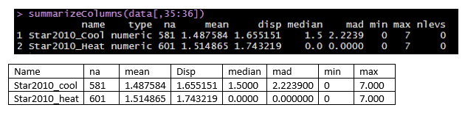
Data Exploration: Star Rating
Determined from the size and energy consumption of the product
Low performance, lower stars, high performance, more stars
How the data is like:

Slide 6
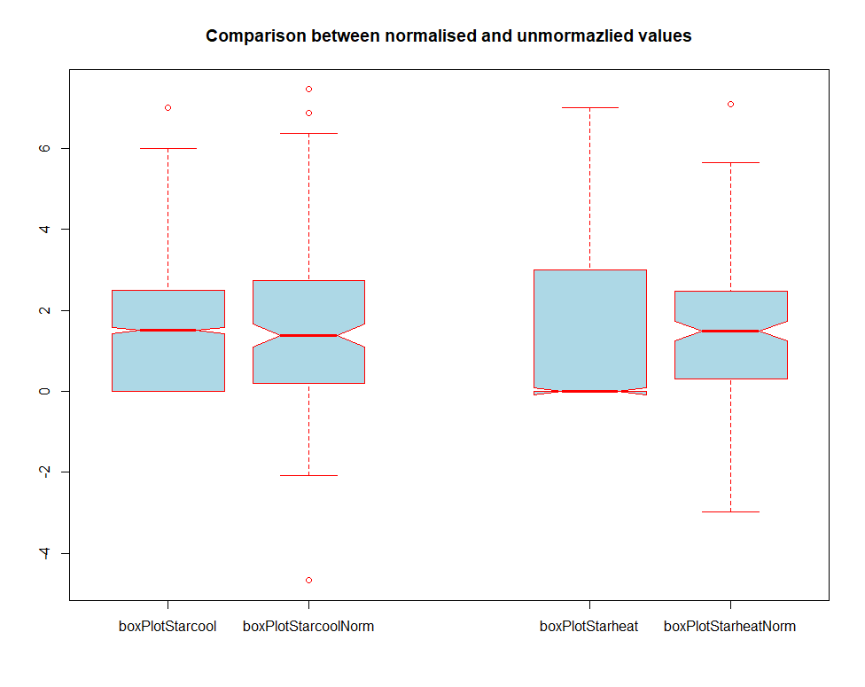
Data Exploration: Star Rating

Slide 7
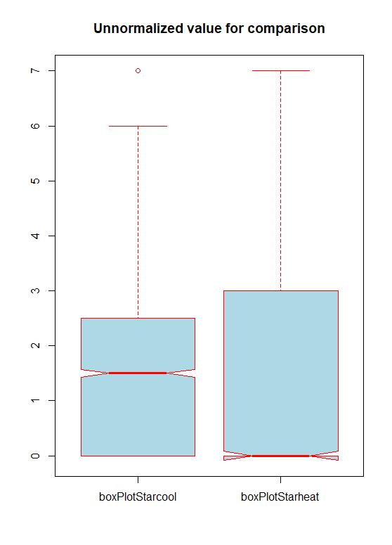
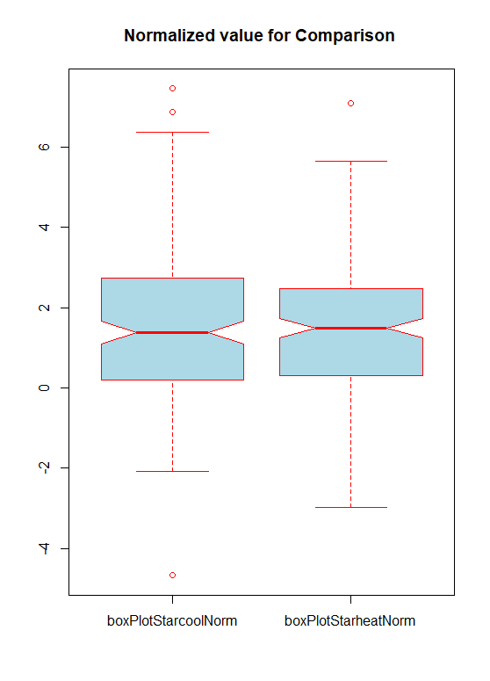
Data Exploration: Star Rating

Slide 8
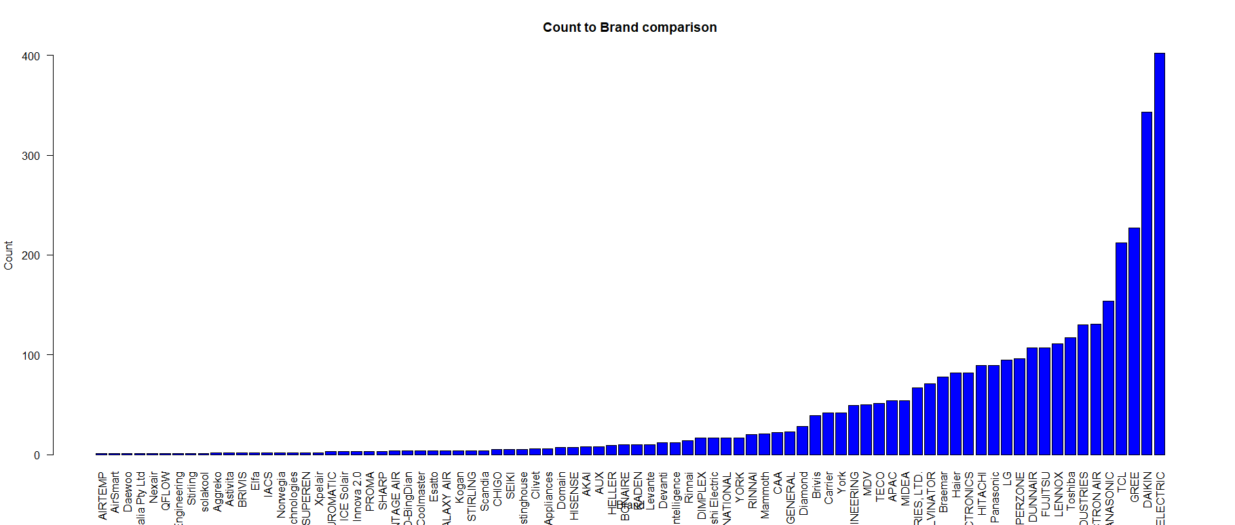
Data Exploration: Brands

Slide 9
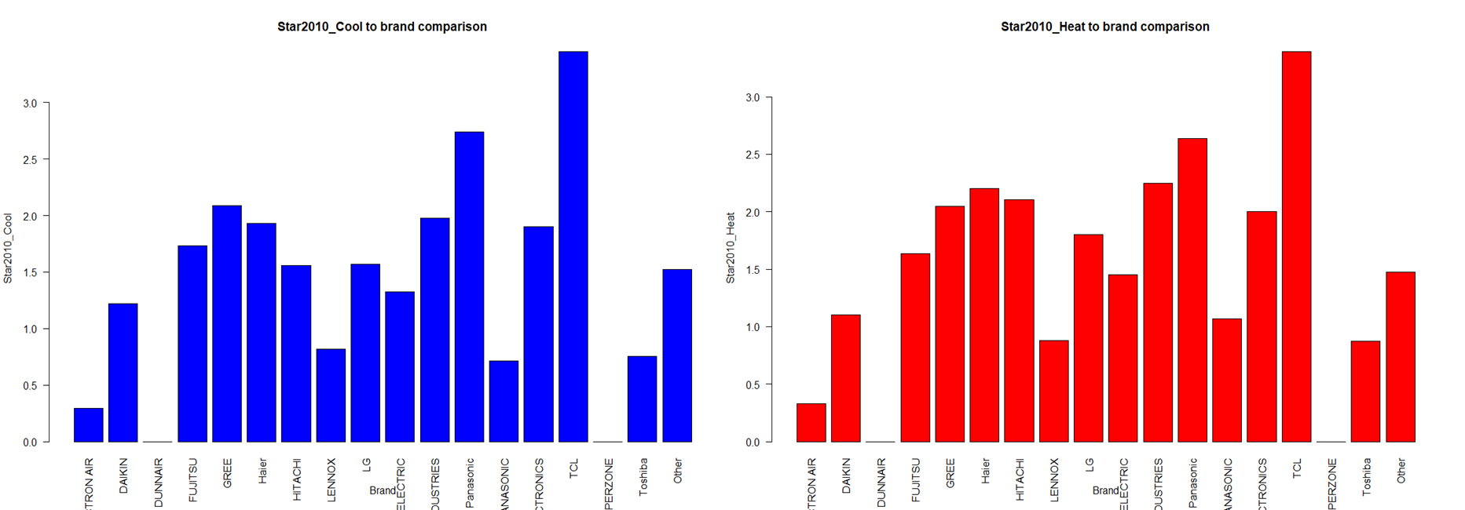
Data Exploration: Relationship between variables
Brand and Star
Notes:
From this chart, we can clearly observe that the brand “TCL” has the highest cool and heat star rating. Cross reference back to the database shows that “TCL” is producing very efficiency Single Split System with Invertor air con that are averaging up the rating.
Recommendation:
So if a new customer want a highly efficiency A/C, we could highly recommend the buyer to select a model from “TCL”.

Slide 10
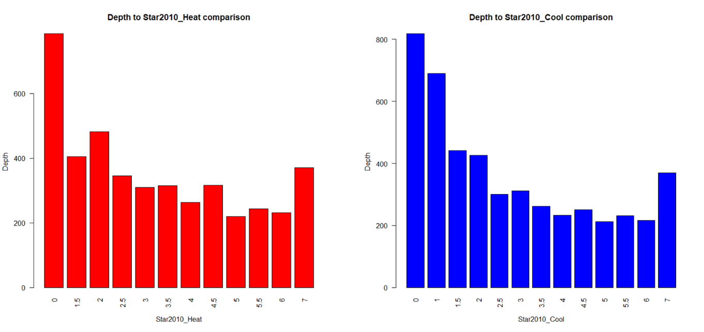
Data Exploration: Relationship between variables
Average Depth and Star
Notes:
Observation:
From the chart above, it is showing that the depth is larger it is having lower star rating. As can be seem, the chart is linearly shifting downwards from the depth is smaller and the star rating is increasing. The relationship from both heat and cool showing that to have a smaller unit will have a better star rating.
Recommendation:
Based on this observation, it can be said that with reference back to data source, generally it is wall hung, single split system that will have smaller depth while cassette, single split system having larger depth. With this in mind, a new buyer can base on the type of A/C type to select for better rating.

Slide 11
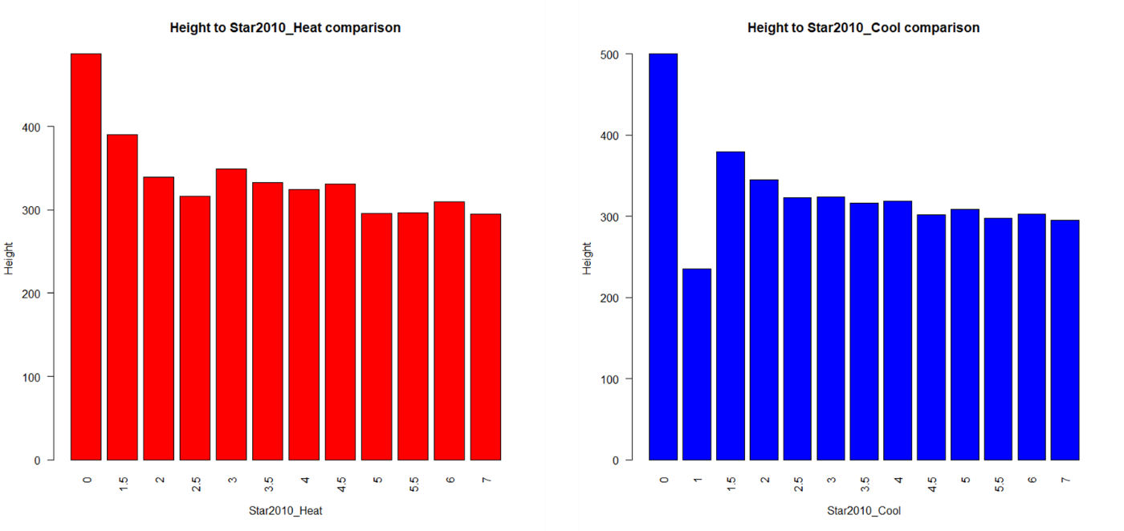
Data Exploration: Relationship between variables
Average Height and Star
Notes:
Observation:
From the chart above, it is showing that when the height is larger it is having lower star rating. As can be seem, the chart is linearly shifting downwards from the depth is smaller and the star rating is increasing. The relationship from both heat and cool showing that to have a smaller unit will have a better star rating. The reason for the sudden rise in star 7 is because there is a outliers which consist only 1 or couple of records that is 7 starred but with middle sized dimension.
Recommendation:
Based on this observation, it can be said that with reference back to data source, generally it is wall hung, single split system that will have smaller depth while cassette, single split system having larger depth. With this in mind, a new buyer can base on the type of A/C type to select for better rating.

Slide 12
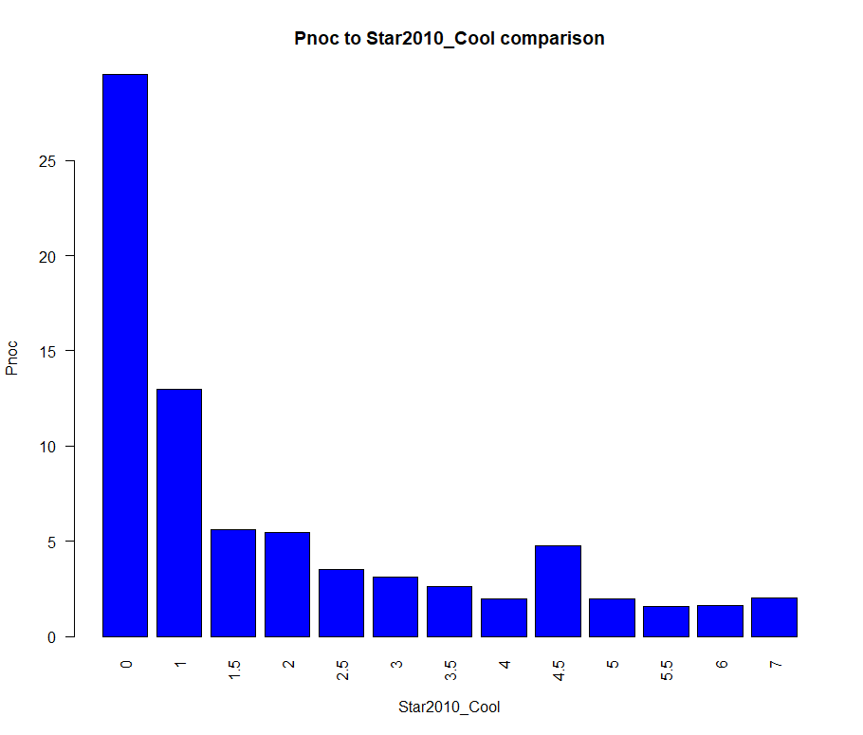
Data Exploration: Relationship between variables
Pnoc and Star Cool
Notes:
Pnoc: Non-operative power for cooling mode (lower the better). This is now mandatory and replaces “avg_pwr_standby_mode”.
Observation:
There is a trend where the higher the average of Pnoc the lower are the star_cool ratings. With an exception for pnoc average at 4.5 stars

Slide 13
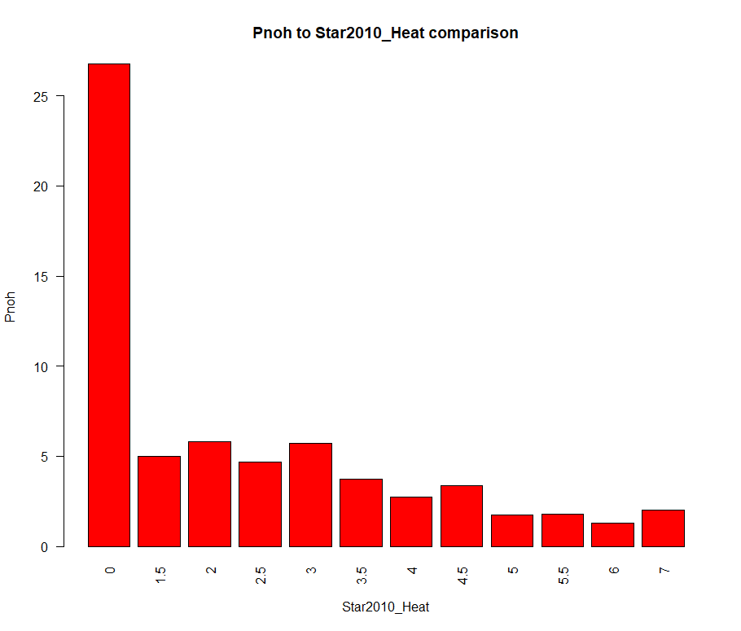
Data Exploration: Relationship between variables
Pnoc and Star Heat
Notes:
Pnoc: Non-operative power for heating mode (lower the better) . This is now mandatory and replaces “avg_pwr_standby_mode”.
Observation:
There is a trend where the lower the average of Pnoh the better are the star_heat ratings. With an exception for pnoh average at 4.5 stars. Generally there are low pnoc ratings
From comparing pnoc and pnoh the cool have a higher Non-operative power generally

Slide 14
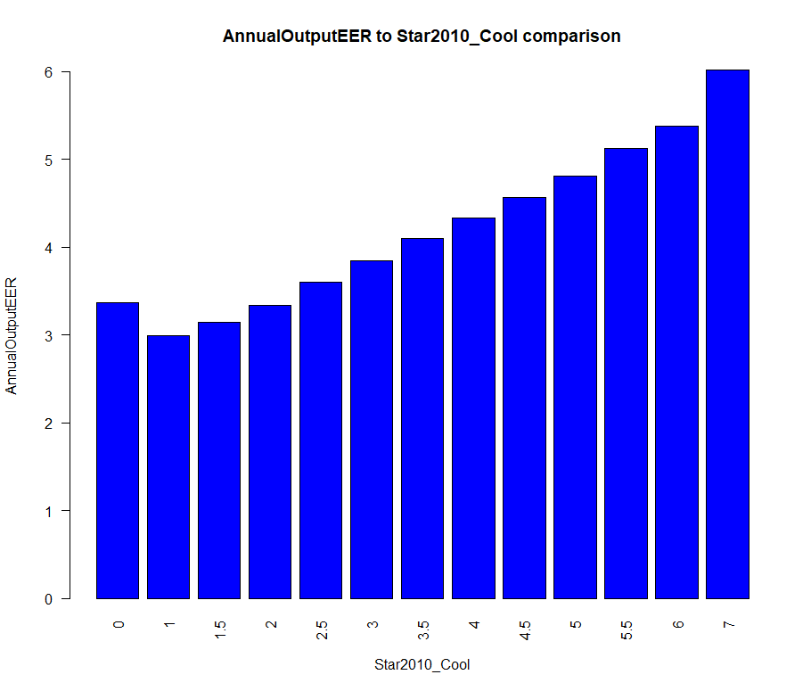
Data Exploration: Relationship between variables
Annual OutputEER and Star Cool
Notes:
AnnualOutputEER : This is cooling energy efficiency (kW/kW) incorporating inoperative power consumption. This metric is what the MEPS level is based upon and has been in use since 2010.
Observation:
There is a trend where the higher the average of AnnualOutputEER the better are the star_cool ratings.

Slide 15
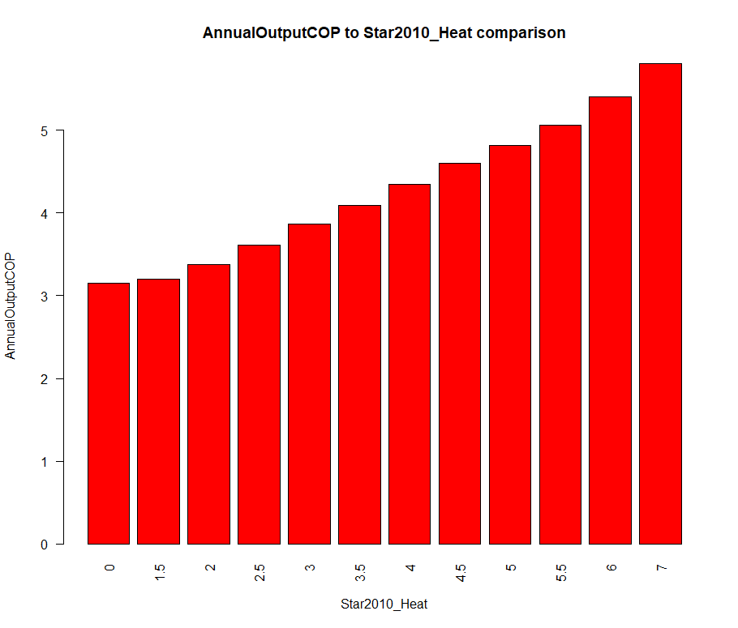
Data Exploration: Relationship between variables
Annual OutputCOP and Star Cool
Notes:
AnnualOutputCOP: This is heating energy efficiency (kW/kW) incorporating inoperative power consumption. This metric is what the MEPS level is based upon and has been in use since 2010.
Observation:
There is a trend where the higher the average of AnnualOutputCOP the better are the star_heat ratings.

Slide 16
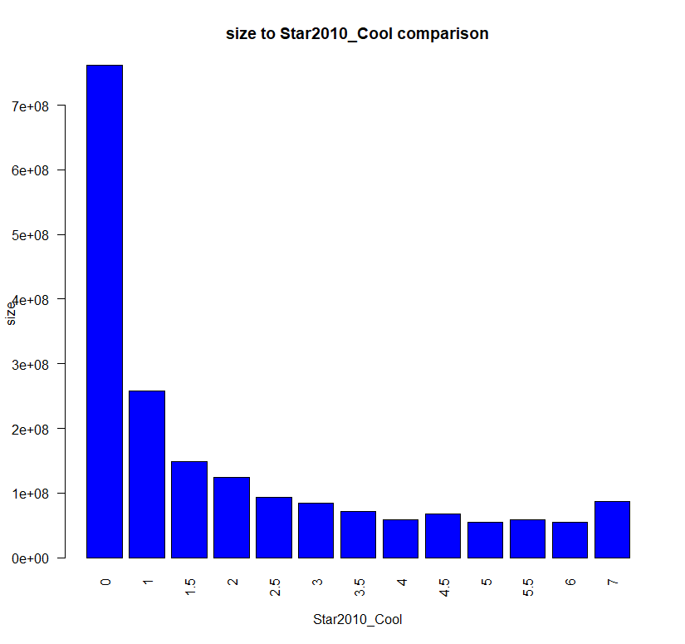
Data Exploration: Relationship between variables
Size and Star Cool: Size = data$size<-data$Height*data$Depth*data$Width
Notes:
Observation:
Larger size, lower ratings as it can be seen. As mentioned, size is one of the determinant for the performance

Slide 17
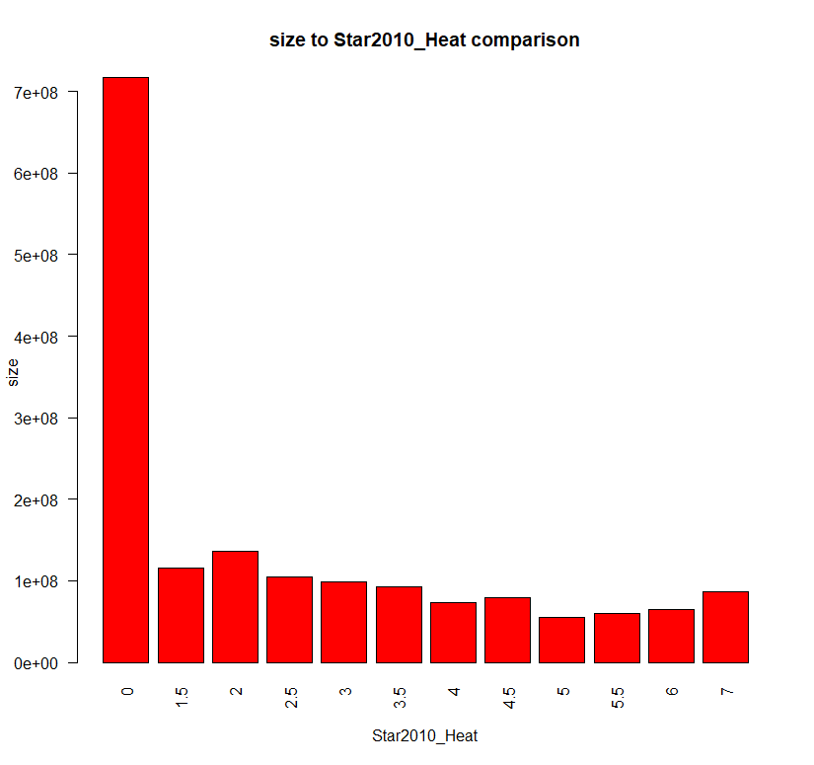
Data Exploration: Relationship between variables
Size and Star Cool: Size = data$size<-data$Height*data$Depth*data$Width
Notes:
Observation:
Larger size, lower ratings as it can be seen. As mentioned, size is one of the determinant for the performance

Slide 18
Methods: Predictive Models
Model for predicting the SRI values (quantitative) of air conditioners according to the new star rating system used since 2010, using other relevant variables apart from the star ratings. Do this for both their cooling and their heating ratings.
Propose a model to predict the yearly energy consumption of the air conditioner in heating and a model to predict it in cooling.

Slide 19
Methods: Predictive Models Model for predicting the SRI values
Linear regression model + gradient boosting
The random forest model is for feature selection. Then i use those features for regression model and a gradient boosted model for prediction of regression model's accuracy. Most appropriate for the use case as it is easily interpretable
Predictive attributes:
AnnualOutputEER
AnnualOutputCOP
sri2010_cool
sri2010_heat
Notes:
% Inc MSE is the most robust and informative measure. It is the increase in mse (mean squared error) of predictions (estimated with out-of-bag-CV) as a result of variable j being permuted (values randomly shuffled).
grow regression forest. Compute OOB-mse, name this mse0.
for 1 to j var: permute values of column j, then predict and compute OOB-mse(j)
% Inc MSE of j’th is (mse(j)-mse0)/mse0 * 100%
The higher the number, the more important IncNodePurity relates to the loss function which by best splits are chosen. The loss function is mse for regression and gini-impurity for classification. More useful variables achieve higher increases in node purities, that is to find a split which has a high inter node ‘variance’ and a small intra node ‘variance’. Inc Node Purity is biased and should only be used if the extra computation time of calculating % Inc MSE is unacceptable.

Slide 20
Data Preprocessing
library(randomForest)
library(mlr)
library(caret) #this package has the createDataPartition function
library(forcats)
data<-read.csv("new.csv")
data$Brand<-fct_lump(data$Brand, 17)
data$Country<-fct_lump(data$Country, 12)
data$ExpDate<-format(as.Date(data$ExpDate, format="%d/%m/%Y"),"%Y") #0020
data$ExpDate<-as.factor(data$ExpDate)
cols <- sapply(data, is.logical)
data[,cols] <- lapply(data[,cols], as.numeric)
imp <- impute(data, classes = list(factor = imputeMode(), logical= imputeMode(), integer = imputeMedian(), numeric= imputeMedian()), dummy.classes = c("factor", "logical","integer","numeric"), dummy.type = "numeric")
impdata <- imp$data
new_impdata <- impdata[, which(names(impdata) %in% c("N.Standard", "Configuration2.unitmount", "C.Total.Cool.Rated", "EERtestAvg", "COPtestAvg", "AnnualOutputEER", "AnnualOutputCOP", "Product Class", "outdoortype","sri2010_heat", "Star2010_Cool", "Star2010_Heat", "EER", "Rated.cooling.power.input.kW", "Rated.ACOP", "sri2010_cool"))]

Slide 21
Data Preprocessing
#remove outliers extremely large values
cd <- capLargeValues(new_impdata, target = "sri2010_cool",cols = c("C.Total.Cool.Rated"),threshold = 2.4)
cd <- capLargeValues(cd, target = "sri2010_cool",cols = c("EERtestAvg"),threshold =2.9688)
cd <- capLargeValues(cd, target = "sri2010_cool",cols = c("AnnualOutputEER"),threshold = 2.91183479)
cd <- capLargeValues(cd, target = "sri2010_cool",cols = c("EER"),threshold = 2.9688)
cd <- capLargeValues(cd, target = "sri2010_cool",cols = c("Rated.cooling.power.input.kW"),threshold = 0.4)
cd$C.Total.Cool.Rated<- scale(cd$C.Total.Cool.Rated, scale = FALSE)
cd$EERtestAvg<- scale(cd$EERtestAvg, scale = FALSE)
cd$AnnualOutputEER<- scale(cd$AnnualOutputEER, scale = FALSE)
cd$EER<- scale(cd$EER, scale = FALSE)
cd$Rated.cooling.power.input.kW<- scale(cd$Rated.cooling.power.input.kW, scale = FALSE)
cd$sri2010_cool<- scale(cd$sri2010_cool, scale = FALSE)
cd$sri2010_heat<- scale(cd$sri2010_heat, scale = FALSE)
summarizeColumns(cd)
str(cd) #90 variables

Slide 24
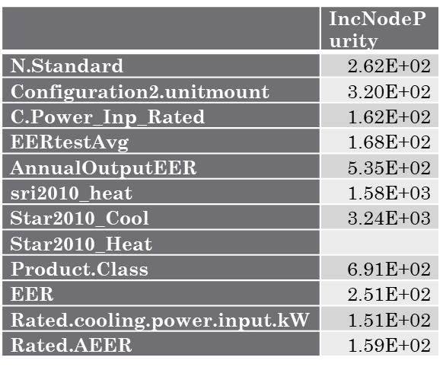
Methods: Predictive Models Model for predicting the SRI values
Random forest
Significant features

Slide 25
Methods: Predictive Models Model for predicting the SRI values
Comparing root mean squared error for regression, kvsvm and ranger model
Significant features
Notes:
In boosting, each new tree is a fit on a modified version of the original data set. The AdaBoost Algorithm begins by training a decision tree in which each observation is assigned an equal weight. After evaluating the first tree, we increase the weights of those observations that are difficult to classify and lower the weights for those that are easy to classify. The second tree is therefore grown on this weighted data. Predictions of the final ensemble model is therefore the weighted sum of the predictions made by the previous tree models.
While the AdaBoost model identifies the shortcomings by using high weight data points, gradient boosting performs the same by using gradients in the loss function (y=ax+b+e , e needs a special mention as it is the error term). The loss function is a measure indicating how good are model’s coefficients are at fitting the underlying data. A logical understanding of loss function would depend on what we are trying to optimise. For example, if we are trying to predict the air con cooling ability rating by using a regression, then the loss function would be based off the error between true and predicted sri_2010_cool prices.

Slide 26
regr.task = makeRegrTask(data = cd, target = "sri2010_cool")
regr.task
### Regression gradient boosting machine, specify hyperparameters via a list
regr.lrn = makeLearner("regr.gbm", par.vals = list(n.trees =500, interaction.depth = 5))
### Train the learner
mod = mlr::train(regr.lrn, regr.task)
### Get the number of observations
n = getTaskSize(regr.task)
### Use 1/3 of the observations for training
train.set = sample(n, size = n/3)
### Train the learner
mod = mlr::train("regr.lm", regr.task, subset = train.set)
mod

Slide 27
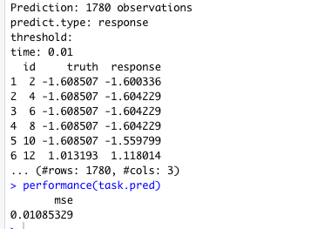
Predictive model for predicting the sri2010_cool values
Mean Square Error
Defined as: mean((response - truth)^2)

Slide 28
Predictive model for predicting the sri2010_heat values

Slide 29
Explaining errors
Error: Functional features have been converted to numerics
As the most well-known machine learning techniques generally do not emphasize the interdependence between features, they are often not well suited for such tasks. Application of these techniques can lead to poor performance. Functional data analysis, on the other hand, tries to address this issue either by using algorithms particularly tailored to functional data or by transforming the functional covariates into a continuum (e.g., time, wavelength) nondependent feature space.

Slide 30
Without scaling the data, but balancing the imbalanced dataset
(column sri2010_cool < 0 and > 0)

Slide 31
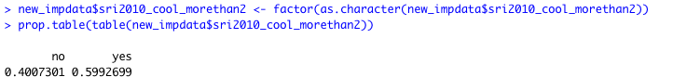
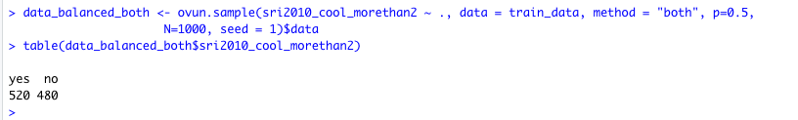

Slide 32
set.seed(42)
index <- createDataPartition(new_impdata$sri2010_cool_morethan2, p = 0.7, list = FALSE)
train_data <- new_impdata[index, ]
test_data <- new_impdata[-index, ]
library(rpart)
treeimb <- rpart(sri2010_cool_morethan2 ~ ., data = train_data)
pred.treeimb <- predict(treeimb, newdata = test_data)
accuracy.meas(test_data$sri2010_cool_morethan2, pred.treeimb[,2])
roc.curve(test_data$sri2010_cool_morethan2, pred.treeimb[,2], plotit = F)
data_balanced_both <- ovun.sample(sri2010_cool_morethan2 ~ ., data = train_data, method = "both", p=0.5, N=1000, seed = 1)$data
table(data_balanced_both$sri2010_cool_morethan2)
data.rose <- ROSE(sri2010_cool_morethan2 ~ ., data = train_data, seed = 1)$data
table(data.rose$sri2010_cool_morethan2)

Slide 33
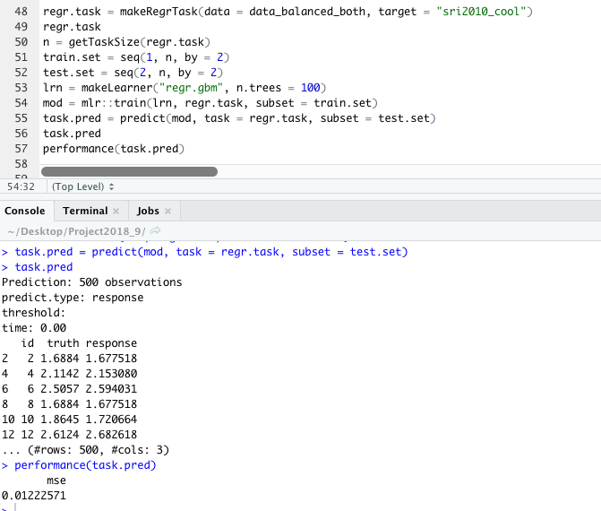

Slide 34
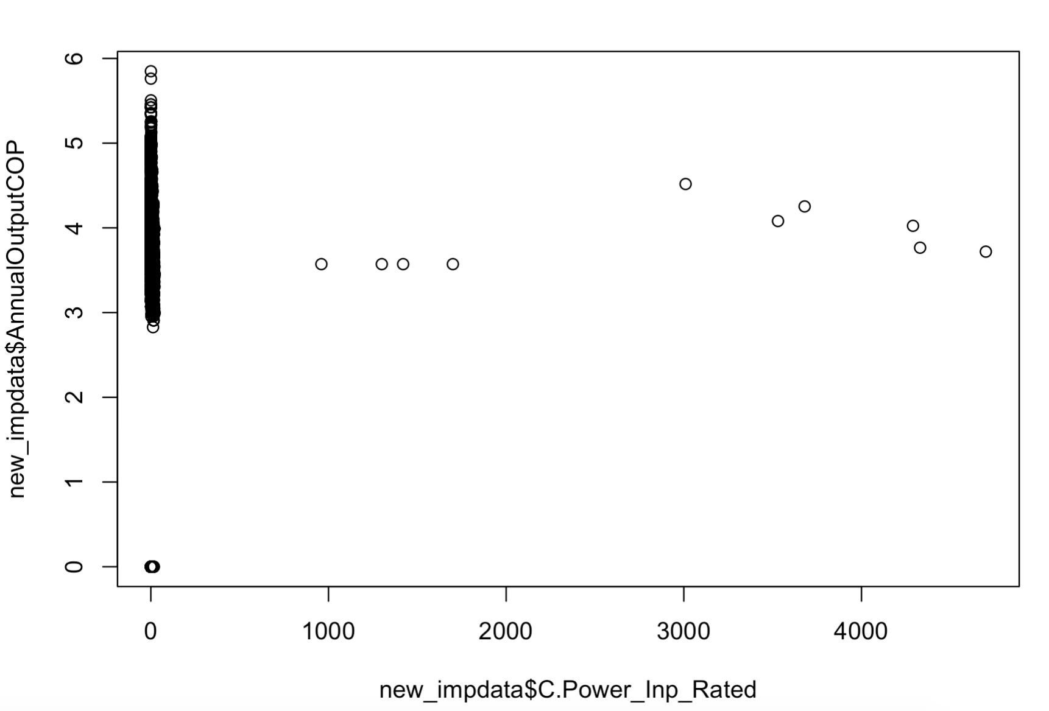
Methods: Predictive Models Predict yearly energy consumption air conditioner
Linear regression model
Chosen based on its relevancy of the prediction

Slide 35
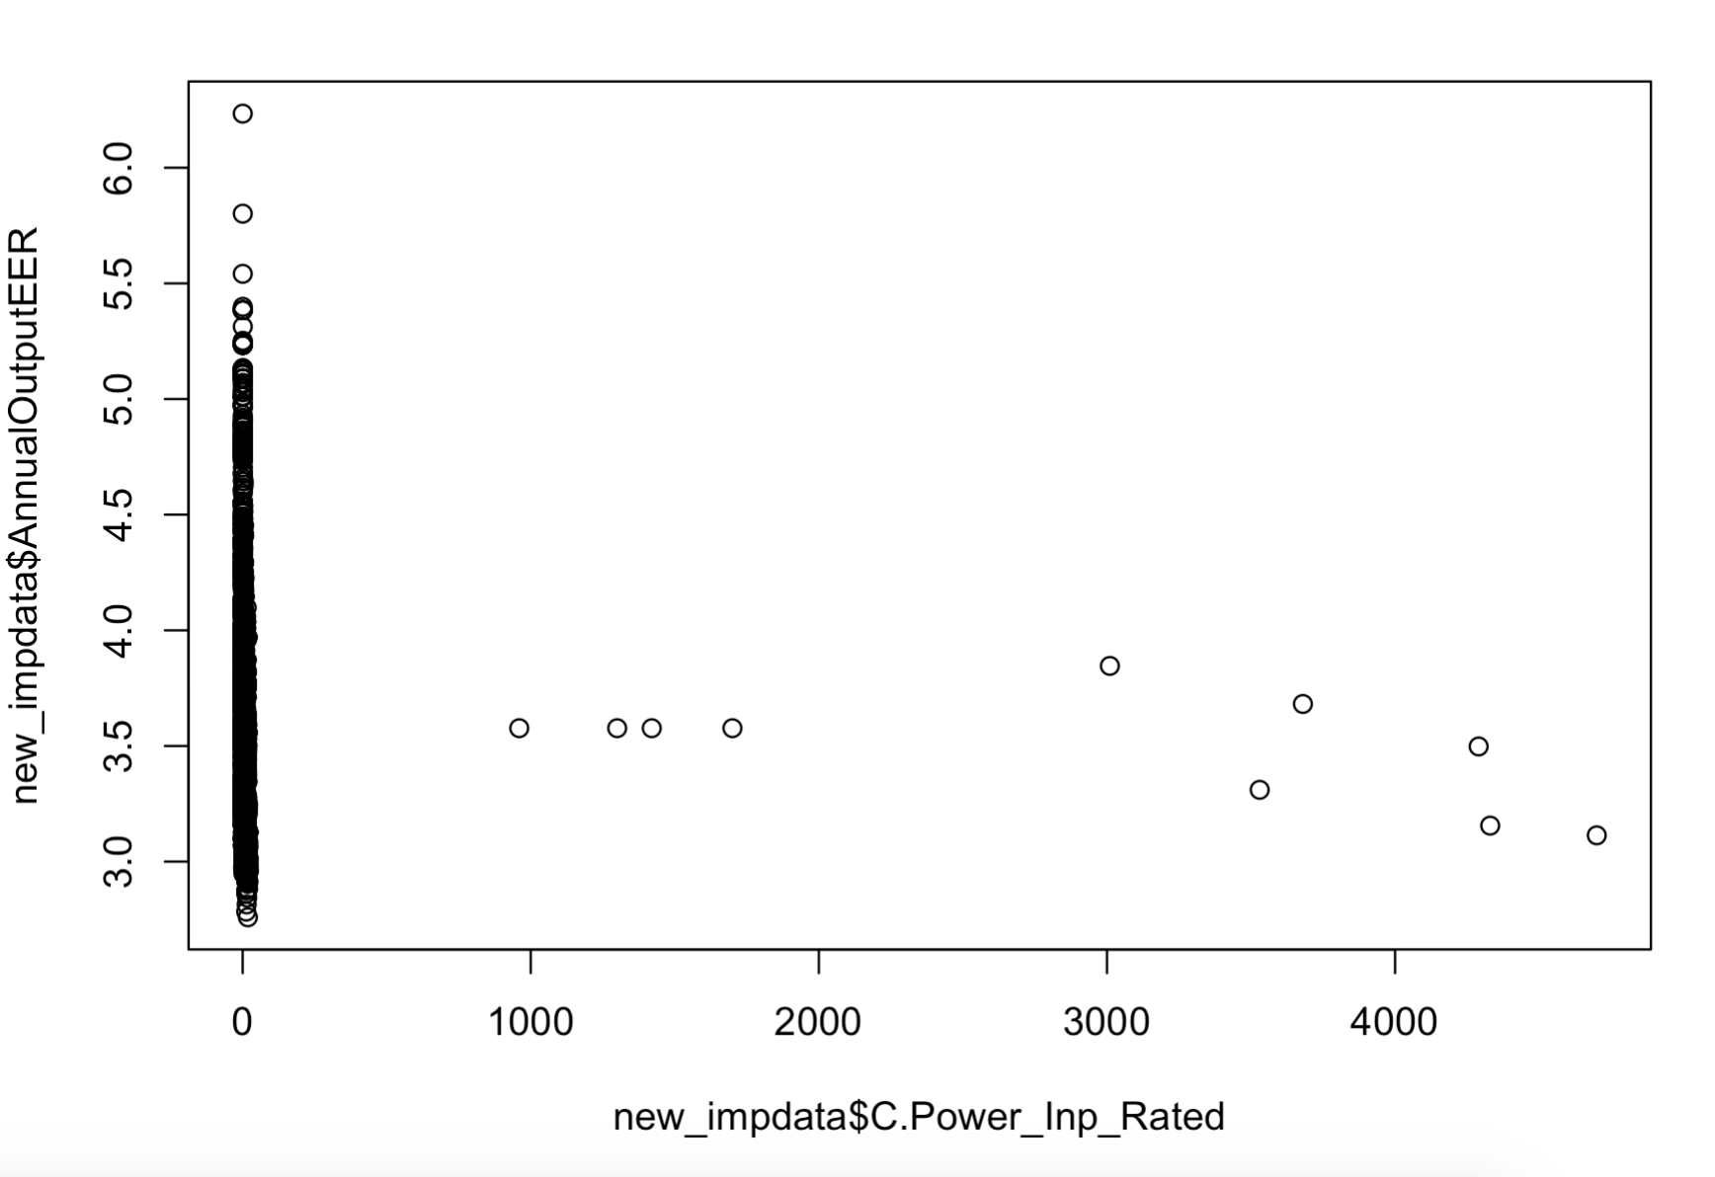
Methods: Predictive Models Predict yearly energy consumption air conditioner
Linear regression model
Chosen based on its relevancy of the prediction

Slide 36
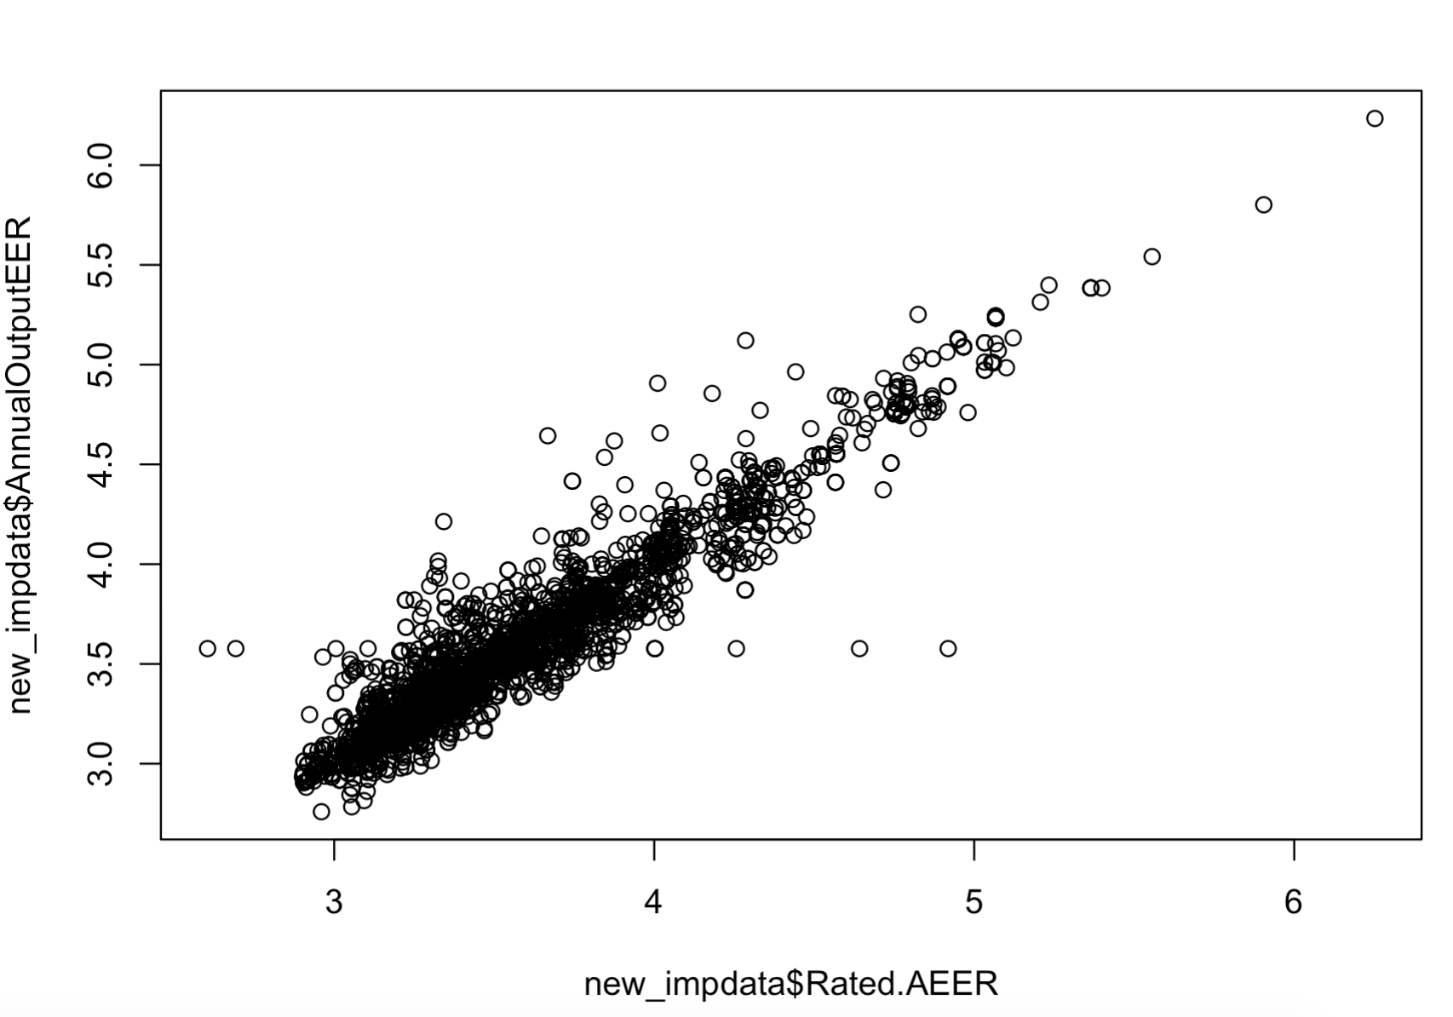
Methods: Predictive Models Predict yearly energy consumption air conditioner
Linear regression model
Chosen based on its relevancy of the prediction

Slide 37
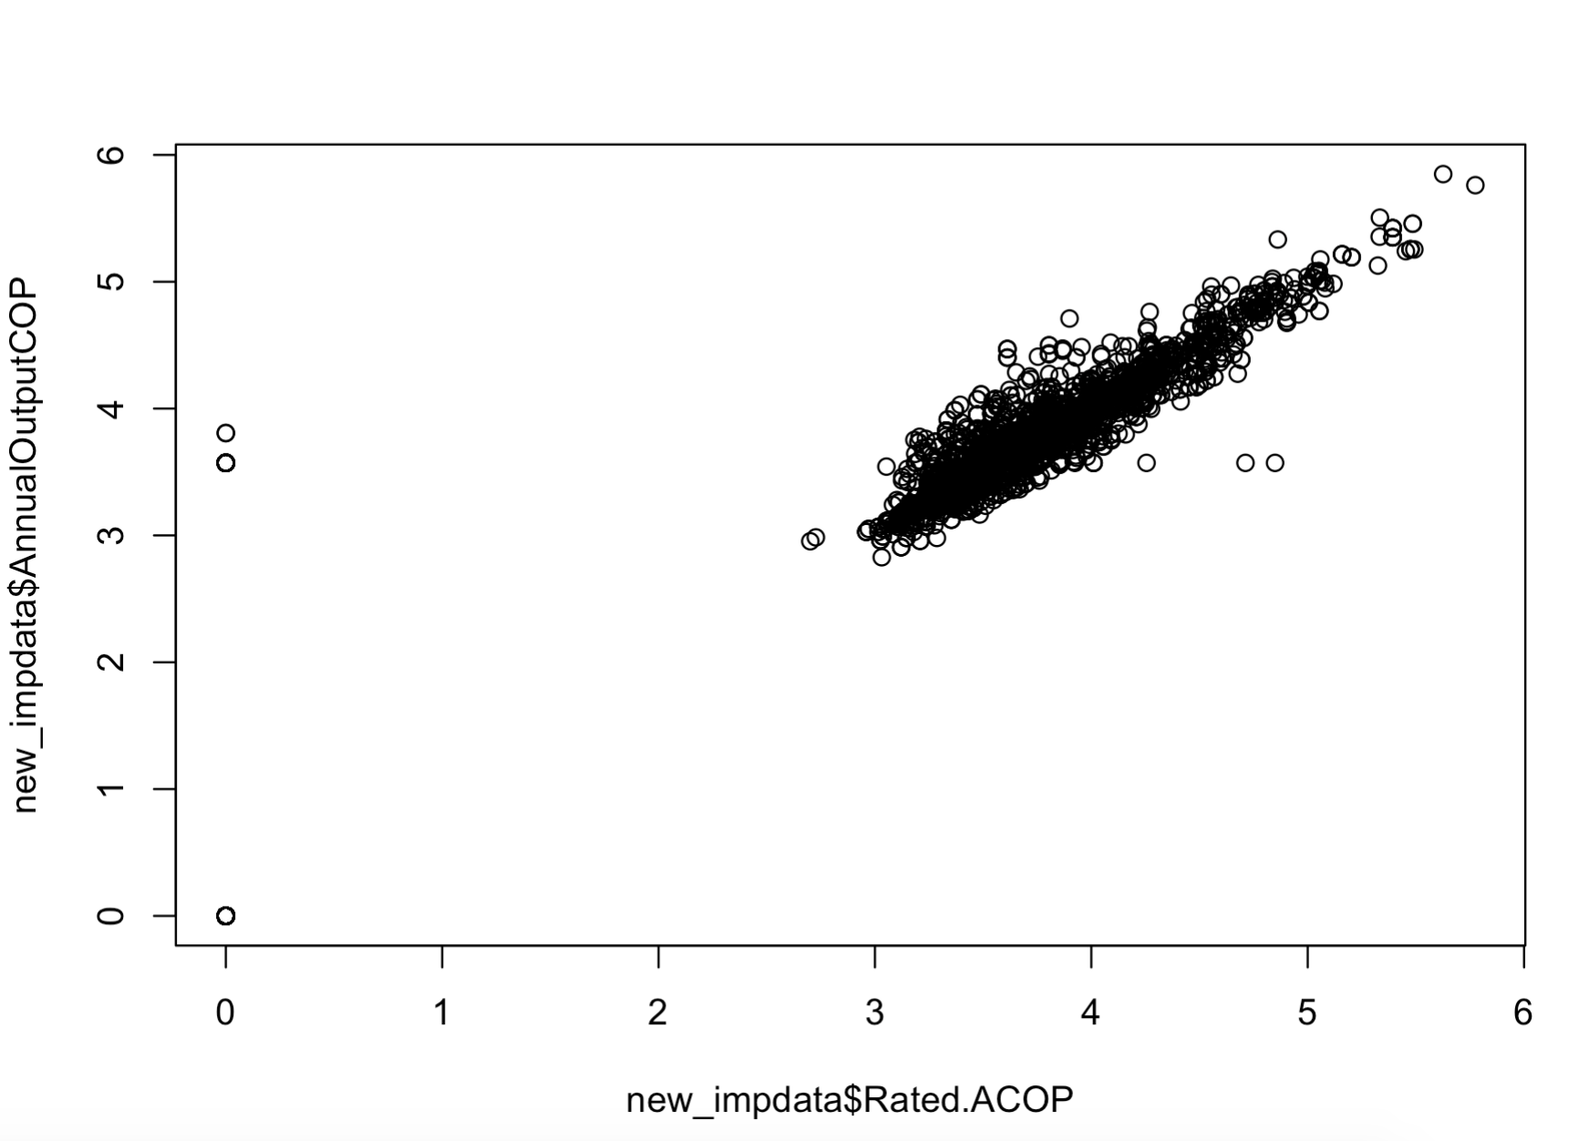
Methods: Predictive Models Predict yearly energy consumption air conditioner
Linear regression model
Chosen based on its relevancy of the prediction

Slide 38
Methods: Predictive Models Predict yearly energy consumption air conditioner
Linear regression model
Findings
Linear regression for EER (Heating)
Residual standard error: 0.04402 on 2769 degrees of freedom
Multiple R-squared: 0.9922, Adjusted R-squared: 0.9919
F-statistic: 4494 on 78 and 2769 DF, p-value: < 2.2e-16
Linear regression for COP (Cooling)
Residual standard error: 0.1299 on 2766 degrees of freedom
Multiple R-squared: 0.9843, Adjusted R-squared: 0.9838
F-statistic: 2140 on 81 and 2766 DF, p-value: < 2.2e-16
R-Squared value: the more the value closer to 1, the better the model is
p-valued: the more the value close to 0, the better the model is
Hence this two value are good enough to predict

Slide 39
Methods: Predictive Models Predict yearly energy consumption air conditioner
Linear regression model
Findings
Linear regression for EER (Heating)
Residual standard error: 0.04402 on 2769 degrees of freedom
Multiple R-squared: 0.9922, Adjusted R-squared: 0.9919
F-statistic: 4494 on 78 and 2769 DF, p-value: < 2.2e-16
Linear regression for COP (Cooling)
Residual standard error: 0.1299 on 2766 degrees of freedom
Multiple R-squared: 0.9843, Adjusted R-squared: 0.9838
F-statistic: 2140 on 81 and 2766 DF, p-value: < 2.2e-16
R-Squared value: the more the value closer to 1, the better the model is
p-valued: the more the value close to 0, the better the model is
Hence this two value are good enough to predict

Slide 40
Discussion: (discovered knowledge from data mining)
Complex models are not inherently better than simplistic models
Principle of diminishing return applies
Computation complexity also rises in tandem with model complexity
Data preprocessing forms a vast majority of time taken in data mining
Having a domain knowledge of the dataset object
Missing values, outliers, data abnormalities all impact the accuracy of a model
Using the correct input data variables, a real world date set includes too many non-related data that will affect the modeling
Normalization have to be used for some of the input data as with or without will affect the output
Selection of data model
There are many models to choose from and the selection of which one to use greatly affect the output of the mining. We have to try out different models and pick which is able to represent our targeted finding. There is no one model which will really “fit all”.
Interpretation from the mining
Though we can identify the pattern or relation from the mining, it is not inherently clear why and what caused it. We still have to revert back to the raw dataset to analyse and find the actual data object to give for our recommendation

